Slide 1
Chapter 1 Introduction: Operating Systems && Networks
Tanenbaum, Modern Operating Systems 3 e, (c) 2008 Prentice-Hall, Inc. All rights reserved. 0-13-6006639
Notes:
1

Slide 2
What Is An Operating System?
Lots of hardware !!
One or more processors
Main memory
Disks
Printers
Various input/output devices
Managing all these components requires a layer of software – the operating system
Tanenbaum, Modern Operating Systems 3 e, (c) 2008 Prentice-Hall, Inc. All rights reserved. 0-13-6006639

Slide 3
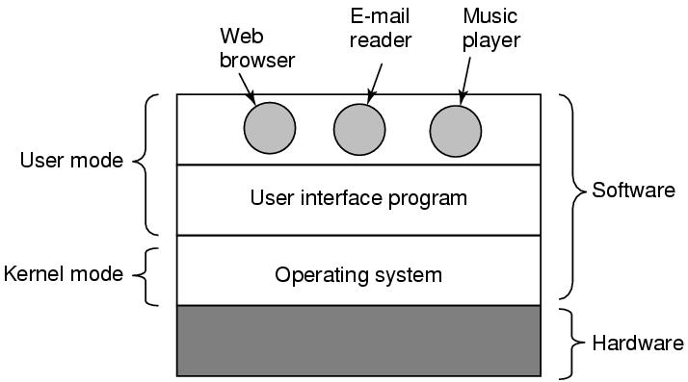
Where is the software?
Where the operating system fits in.
Tanenbaum, Modern Operating Systems 3 e, (c) 2008 Prentice-Hall, Inc. All rights reserved. 0-13-6006639

Slide 4
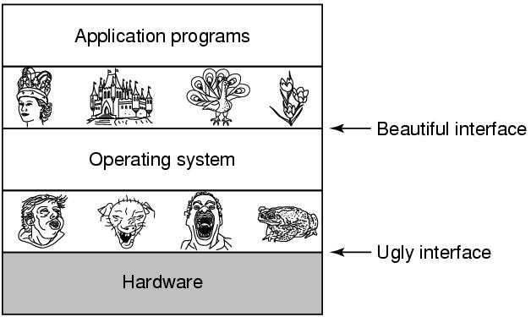
The Operating System as an Extended Machine
Tanenbaum, Modern Operating Systems 3 e, (c) 2008 Prentice-Hall, Inc. All rights reserved. 0-13-6006639

Slide 5
The Operating System as a Resource Manager
Allow multiple programs to run at the same time
Manage and protect memory, I/O devices, and other resources
Multiplexes (shares) resources in two different ways:
In time
In space
Tanenbaum, Modern Operating Systems 3 e, (c) 2008 Prentice-Hall, Inc. All rights reserved. 0-13-6006639

Slide 6
History of Operating Systems
Generations:
(1945–55) Vacuum Tubes
(1955–65) Transistors and Batch Systems
(1965–1980) ICs and Multiprogramming
(1980–Present) Personal Computers, Tablets, Phones
Tanenbaum, Modern Operating Systems 3 e, (c) 2008 Prentice-Hall, Inc. All rights reserved. 0-13-6006639

Slide 7
Why are Operating Systems Used?
It controls all the computer resources.
It provides valuable services to user programs.
It coordinates the execution of user programs.
It provides resources for user programs.
It provides an interface (virtual machine) to the user.
It hides the complexity of software.
It supports multiple execution modes.
It monitors the execution of user programs to prevent errors.

Slide 8
Functions of an Operating System 1- Memory Management

Slide 9
Functions of an Operating System 2- Processor Management

Slide 10
Functions of an Operating System 3- Device Management
Keeps track of all devices connected to the system. Designates a program responsible for every device known as the Input/Output controller.
Decide which process gets access to a certain device and for how long.
Allocates devices effectively and efficiently. Deallocates devices when they are no longer required.
There are various input and output devices. An OS controls the working of these input-output devices.
It receives the requests from these devices, performs a specific task, and communicates back to the requesting process.

Slide 11
Functions of an Operating System 4- File Management

Slide 12
Functions of an Operating System 5- User Interface or Command Interpreter

Slide 13
Functions of an Operating System 6- Booting the Computer
The process of starting or restarting the computer is known as booting.
If the computer is switched off completely and if turned on then it is called cold booting.
Warm booting is a process of using the operating system to restart the computer.

Slide 14
Functions of an Operating System 7- Security
The operating system uses password protection to protect user data and similar other techniques.
it also prevents unauthorized access to programs and user data.
The operating system provides various techniques which assure the integrity and confidentiality of user data.

Slide 15
Functions of an Operating System 8- Control Over System Performance

Slide 16
Functions of an Operating System 9- Error-Detecting Aids
The operating system constantly monitors the system to detect errors and avoid malfunctioning computer systems.
From time to time, the operating system checks the system for any external threat or malicious software activity.
It also checks the hardware for any type of damage. This process displays several alerts to the user so that the appropriate action can be taken against any damage caused to the system.

Slide 17
Functions of an Operating System 10- Network Management
Network Communication: Think of them as traffic cops for your internet traffic. Operating systems help computers talk to each other and the internet. They manage how data is packaged and sent over the network, making sure it arrives safely and in the right order.
Settings and Monitoring: Think of them as the settings and security guard for your internet connection. They also let you set up your network connections, like Wi-Fi or Ethernet, and keep an eye on how your network is doing. They make sure your computer is using the network efficiently and securely, like adjusting the speed of your internet or protecting your computer from online threats.

Slide 18
More third generation
Time Sharing (CTSS)
Multics
Unix
Linux
.
Tanenbaum, Modern Operating Systems 3 e, (c) 2008 Prentice-Hall, Inc. All rights reserved. 0-13-6006639
Notes:
MULTICS
Timesharing CTSS (MIT)
Multics
UNix

Slide 19
Fourth generation
PCs
Network Operating Systems
Distributed Operating Systems
.
Tanenbaum, Modern Operating Systems 3 e, (c) 2008 Prentice-Hall, Inc. All rights reserved. 0-13-6006639
Notes:
MULTICS
Timesharing CTSS (MIT)
Multics
UNix

Slide 20
Network
Group of computer (devices) connected to each other to provide services to users.

Slide 21
Network Services
Data Sharing ( File Server ).
Resource Sharing ( Printer, Scanner ).
Modern Tech ( VoIP, Video Conf, IoT, Clouding )

Slide 22
Network Components:
End Devices ( PC, Labtop, Camera, IPPhone, Printer)
Network Devices ( hub, bridge, repeater, switch, Router, Firewall, AP )
Media ( Wired, Wireless )

Slide 23
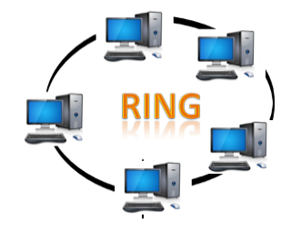
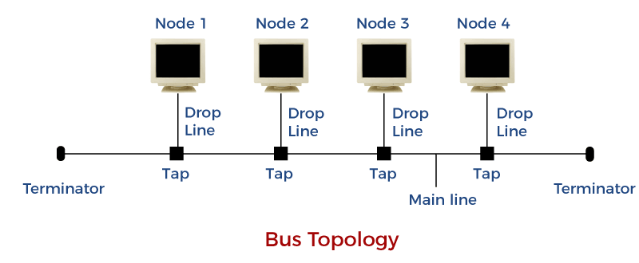
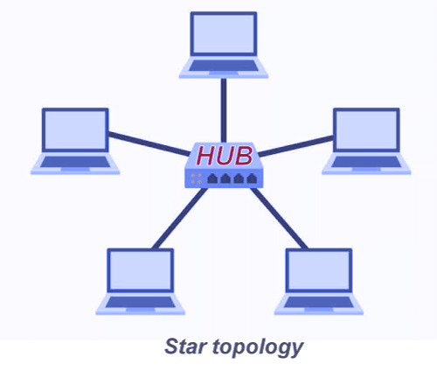
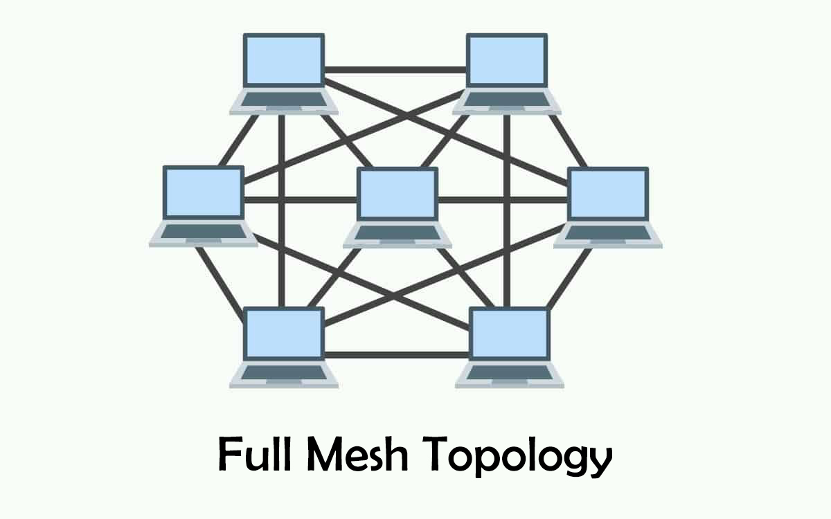
Network Topology
Bus
Star
Ring
Mesh

Slide 24
Communications On the Computer Network
Unicast
Multicast
Broadcast

Slide 25
Network Layers (OSI)

Slide 26
Network Layers (TCP/IP)

Slide 27
Application Protocols and it Ports
There are 65,535 possible port numbers, although not all are in common use. Some of the most commonly used ports, along with their associated networking protocol, are:
Ports 20 and 21: File Transfer Protocol (FTP). FTP is for transferring files between a client and a server.
Port 22: Secure Shell (SSH). SSH is one of many tunneling protocols that create secure network connections.
Port 25: Historically, Simple Mail Transfer Protocol (SMTP). SMTP is used for email.
Port 53: Domain Name System (DNS). DNS is an essential process for the modern Internet; it matches human-readable domain names to machine-readable IP addresses, enabling users to load websites and applications without memorizing a long list of IP addresses.
Port 80: Hypertext Transfer Protocol (HTTP). HTTP is the protocol that makes the World Wide Web possible.
Port 123: Network Time Protocol (NTP). NTP allows computer clocks to sync with each other, a process that is essential for encryption.
Port 179: Border Gateway Protocol (BGP). BGP is essential for establishing efficient routes between the large networks that make up the Internet (these large networks are called autonomous systems). Autonomous systems use BGP to broadcast which IP addresses they control.
Port 443: HTTP Secure (HTTPS). HTTPS is the secure and encrypted version of HTTP. All HTTPS web traffic goes to port 443. Network services that use HTTPS for encryption, such as DNS over HTTPS, also connect at this port.
Port 500: Internet Security Association and Key Management Protocol (ISAKMP), which is part of the process of setting up secure IPsec connections.
Port 587: Modern, secure SMTP that uses encryption.
Port 3389: Remote Desktop Protocol (RDP). RDP enables users to remotely connect to their desktop computers from another device.

